Slide 1
Memory Management

Slide 2
Paging
Partition memory into small equal fixed-size chunks and divide each process into the same size chunks
The chunks of a process are called pages
The chunks of memory are called frames
Keep track of all free frames
To run a program of size n pages, need to find n free frames and load program
Internal fragmentation

Slide 3
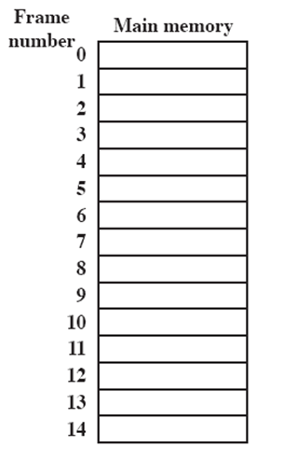
Processes and Frames
A.0
A.1
A.2
A.3
B.0
D.0
B.1
D.1
B.2
D.2
C.0
C.1
C.2
C.3
D.3
D.4
Notes:
Animated slide
System with a number of frames allocated
Process A, stored on disk, consists of four pages. When it comes time to load this process, the operating system finds four free frames and loads the four pages of process A into the four frames.
Process B, consisting of three pages, and process C, consisting of four pages, are subsequently loaded.
Then process B is suspended and is swapped out of main memory.
Later, all of the processes in main memory are blocked, and the operating system needs to bring in a new process, process D, which consists of five pages. The Operating System loads the pages into the available frames and updates the page table

Slide 4
Page Table
Operating system maintains a page table for each process
Contains the frame location for each page in the process
Address generated by CPU is divided into:
Page number (p) – used as an index into a page table which contains base address of each page in physical memory
Page offset (d) – combined with base address to define the physical memory address. It is the displacement within the page table

Slide 5
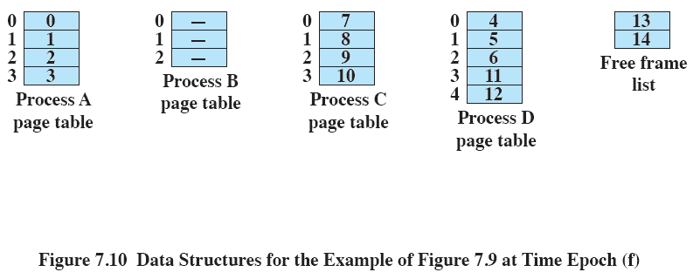
Page Table

Slide 6
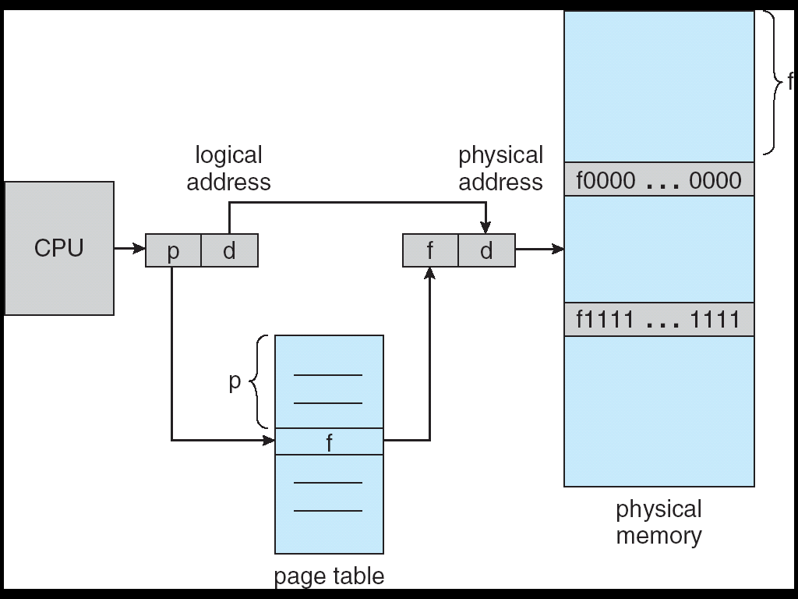
Address Translation Architecture

Slide 7
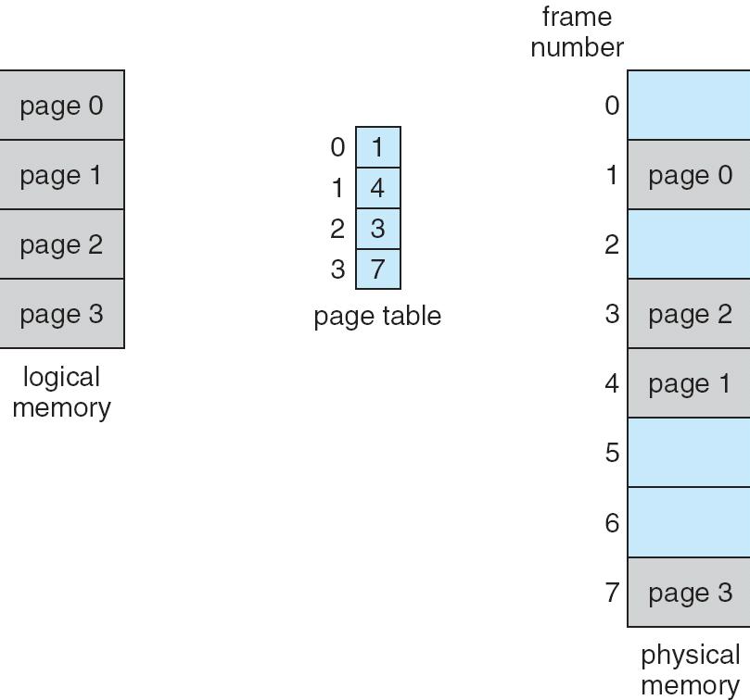
Paging Example

Slide 8
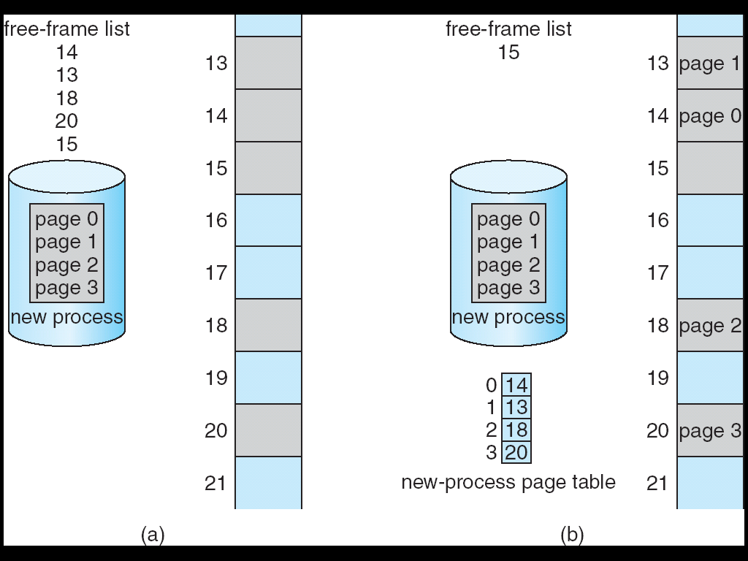
Free Frames
Before allocation
After allocation

Slide 9
Implementation of Page Table
Page table is kept in main memory
Page-table base register (PTBR) points to the page table
Page-table length register (PRLR) indicates size of the page table
In this scheme every data/instruction access requires two memory accesses. One for the page table and one for the data/instruction.
The two memory access problem can be solved by the use of a special fast-lookup hardware cache called associative memory or translation look-aside buffers (TLBs)

Slide 10
Associative Memory
Associative memory – parallel search
Address translation (A´, A´´)
If A´ is in associative register, get frame # out
Otherwise get frame # from page table in memory
Page #
Frame #

Slide 11
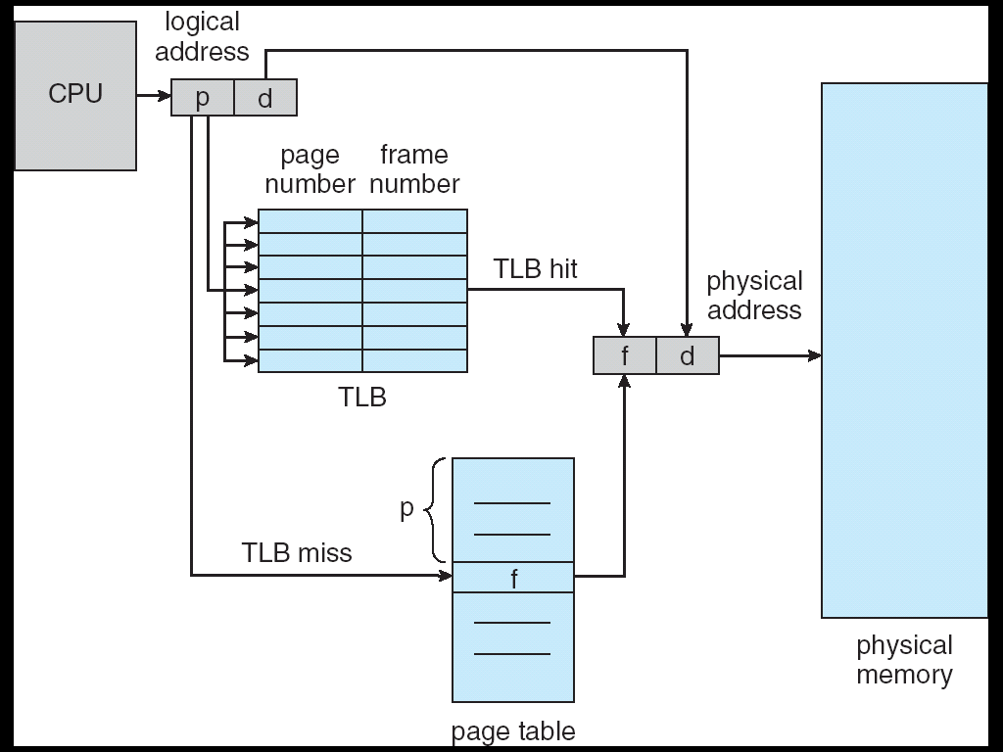
Paging Hardware With TLB

Slide 12
Effective Access Time
Associative Lookup = ε time unit
Assume memory cycle time is 1 microsecond
Hit ratio – percentage of times that a page number is found in the associative registers.

Slide 13
Memory Protection
Memory protection implemented by associating protection bit with each frame
Valid-invalid bit attached to each entry in the page table:
“valid” indicates that the associated page is in the process’ logical address space, and is thus a legal page
“invalid” indicates that the page is not in the process’ logical address space

Slide 14
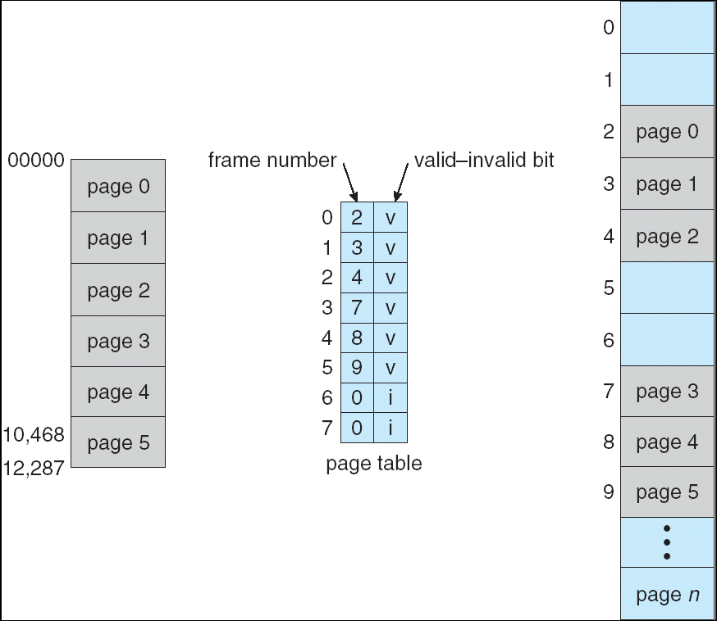
Valid (v) or Invalid (i) Bit In A Page Table

Slide 15
Page Table Structure
Hierarchical Paging
Hashed Page Tables
Inverted Page Tables

Slide 16
Hierarchical Page Tables
Break up the logical address space into multiple page tables
A simple technique is a two-level page table

Slide 17
Two-Level Paging Example
A logical address (on 32-bit machine with 4K page size) is divided into:
a page number consisting of 20 bits
a page offset consisting of 12 bits
Thus, a logical address is as follow where p_{i} is an index into the outer page table, and p₂ is the displacement within the page of the outer page table
page number
page offset
p_{i}
p₂
d
10
10
12

Slide 18
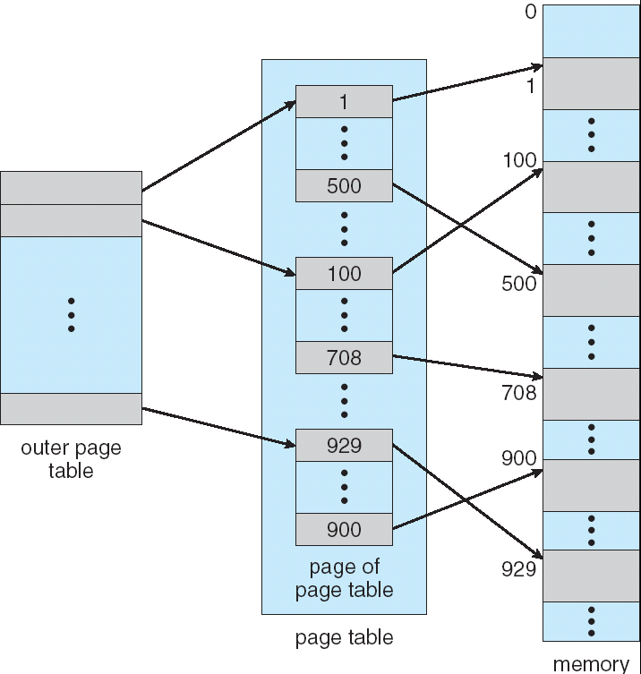
Two-Level Page-Table Scheme

Slide 19
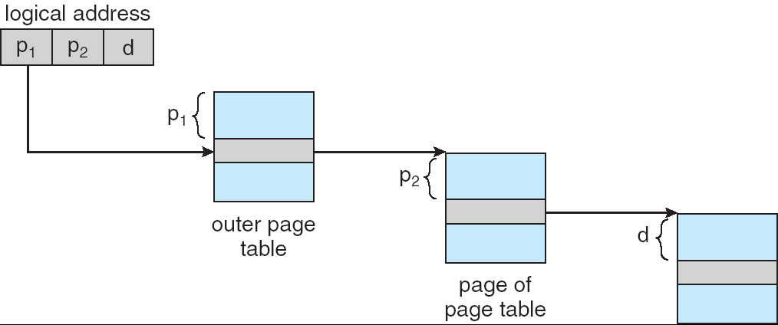
Address-Translation Scheme
Address-translation scheme for a two-level 32-bit paging architecture

Slide 20
Hashed Page Tables
Common in address spaces > 32 bits
The virtual page number is hashed into a page table.
This page table contains a chain of elements hashing to the same location.
Virtual page numbers are compared in this chain searching for a match. If a match is found, the corresponding physical frame is extracted.

Slide 21
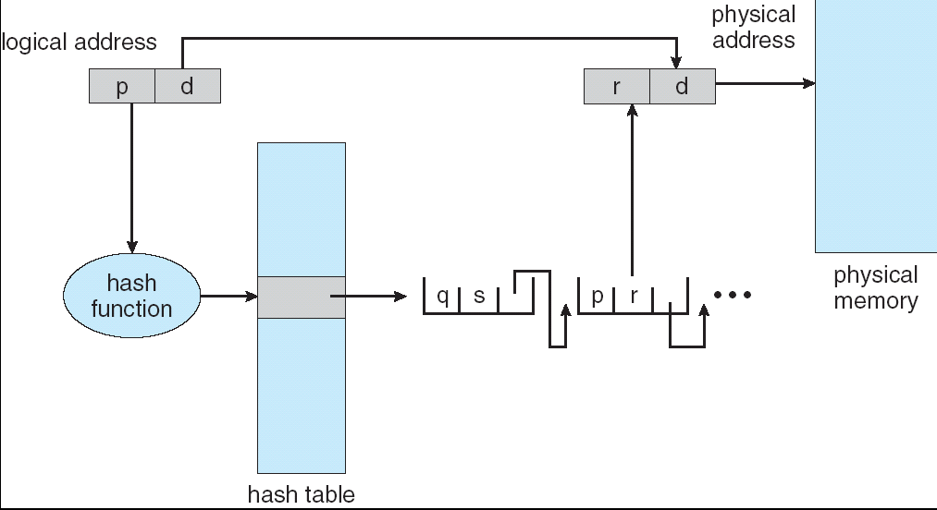
Hashed Page Table

Slide 22
Inverted Page Table
One entry for each real page of memory
Entry consists of the virtual address of the page stored in that real memory location, with information about the process that owns that page
Decreases memory needed to store each page table, but increases time needed to search the table when a page reference occurs
Use hash table to limit the search to one — or at most a few — page-table entries

Slide 23
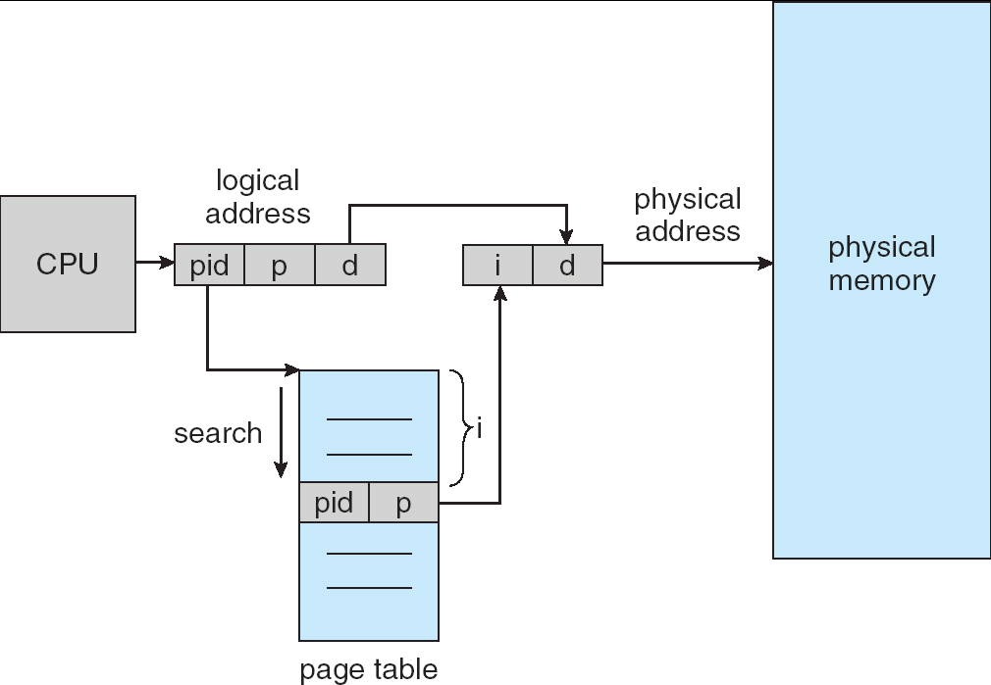
Inverted Page Table Architecture

Slide 24
Shared Pages
Shared code
One copy of read-only (reentrant) code shared among processes (i.e., text editors, compilers, window systems).
Shared code must appear in same location in the logical address space of all processes
Private code and data
Each process keeps a separate copy of the code and data
The pages for the private code and data can appear anywhere in the logical address space

Slide 25
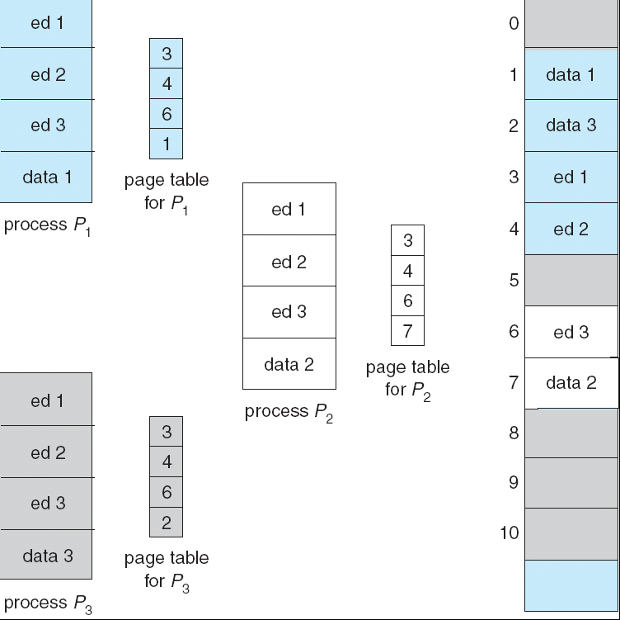
Shared Pages Example

Slide 26
Segmentation
Memory-management scheme that supports user view of memory
A program is a collection of segments. A segment is a logical unit such as:
main program,
procedure,
function,
method,
object,
local variables, global variables,
common block,
stack,
symbol table, arrays

Slide 27
Segmentation
A program can be subdivided into segments
Segments may vary in length
There is a maximum segment length
Addressing consist of two parts
a segment number and
an offset
Segmentation is similar to dynamic partitioning
Notes:
The difference with dynamic partitioning, is that with segmentation a program may occupy more than one partition, and these partitions need not be contiguous.
Segmentation eliminates internal fragmentation but suffers from external fragmentation (as does dynamic partitioning)
However, because a process is broken up into a number of smaller pieces, the external fragmentation should be less.
A consequence of unequal-size segments is that there is no simple relationship between logical addresses and physical addresses.
Analogous to paging, a simple segmentation scheme would make use of a segment table for each process and a list of free blocks of main memory. Each segment table entry would have to give
the starting address in main memory of the corresponding segment.
the length of the segment, to assure that invalid addresses are not used.
When a process enters the Running state, the address of its segment table is loaded into a special register used by the memory management hardware.

Slide 28
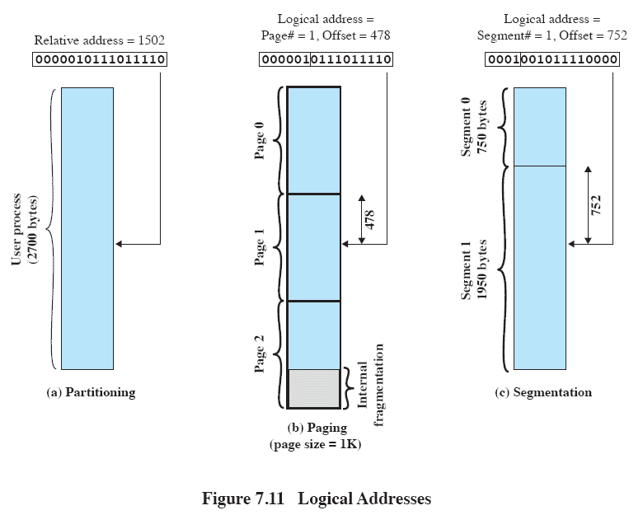
Logical Addresses
Notes:
In this example, 16-bit addresses are used, and the page size is 1K =1024 bytes.
The relative address 1502, in binary form, is 0000010111011110.
With a page size of 1K, an offset field of 10 bits is needed, leaving 6 bits for the page number.
Thus a program can consist of a maximum of 2⁶ =64 pages of 1K bytes each.
As Figure 7.11b shows, relative address 1502 corresponds to
an offset of 478 (0111011110) on page 1 (000001),
which yields the same 16-bit number, 0000010111011110.
Consider an address of n + m bits, where the leftmost n bits are the segment number and the rightmost m bits
are the offset.
In the example on the slide
n = 4 and
m =12.
Thus the maximum segment size is 2¹² = 4096.
The following steps are needed for address translation:
• Extract the segment number as the leftmost n bits of the logical address.
• Use the segment number as an index into the process segment table to find the starting physical address of the segment.
Compare the offset, expressed in the rightmost m bits, to the length of the segment. If the offset is greater than or equal to the length, the address is invalid.
The desired physical address is the sum of the starting physical address of the segment plus the offset.

Slide 29
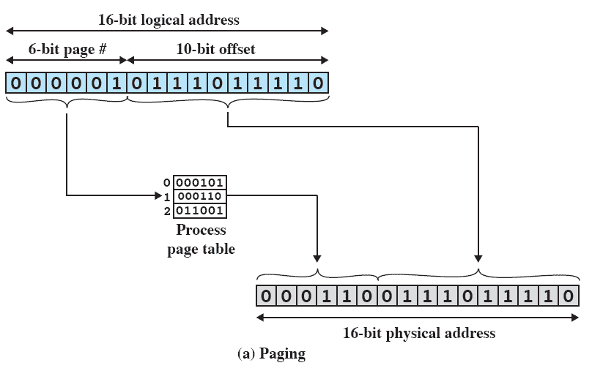
Paging
Notes:
In our example, we have the logical address 0000010111011110,
which is page number 1, offset 478.
Suppose that this page is residing in main memory frame 6 = binary 000110.
Then the physical address is frame number 6, offset 478 = 0001100111011110

Slide 30
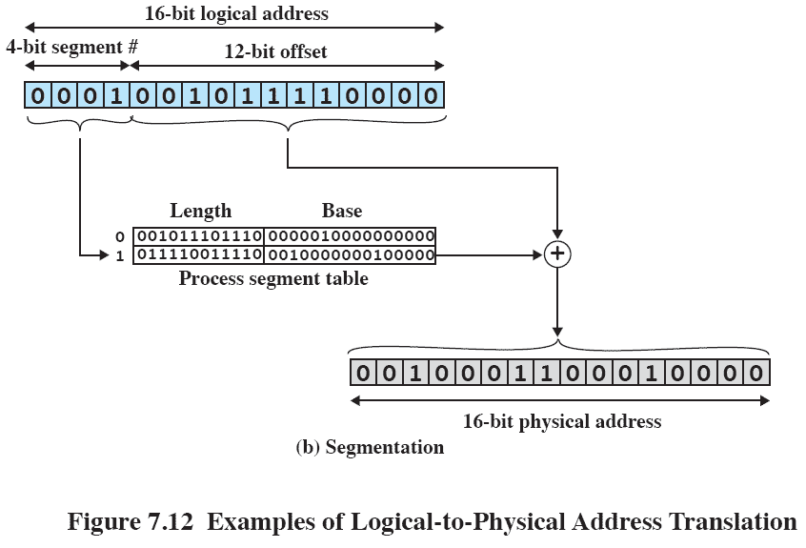
Segmentation
Notes:
In our example, we have the logical address 0001001011110000, which is segment number 1, offset 752.
Suppose that this segment is residing in main memory starting at physical address 0010000000100000.
Then the physical address is 0010000000100000 + 001011110000 = 0010001100010000

Slide 31
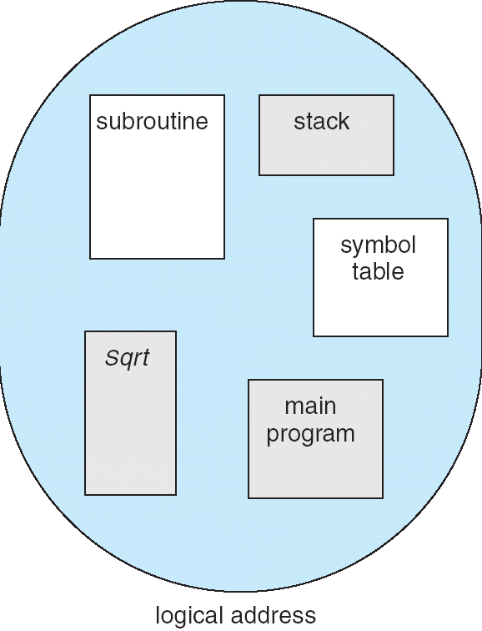
User’s View of a Program

Slide 32
Logical View of Segmentation
1
1
4
2
3
4
2
3
user space
physical memory space

Slide 33
Segmentation Architecture
Logical address consists of a two tuple:
<segment-number, offset>,
Segment table – maps two-dimensional physical addresses; each table entry has:
base – contains the starting physical address where the segments reside in memory
limit – specifies the length of the segment
Segment-table base register (STBR) points to the segment table’s location in memory
Segment-table length register (STLR) indicates number of segments used by a program;
segment number s is legal if s < STLR

Slide 34
Segmentation Architecture (Cont.)
Relocation.
dynamic
by segment table
Sharing.
shared segments
same segment number
Allocation.
first fit/best fit
external fragmentation

Slide 35
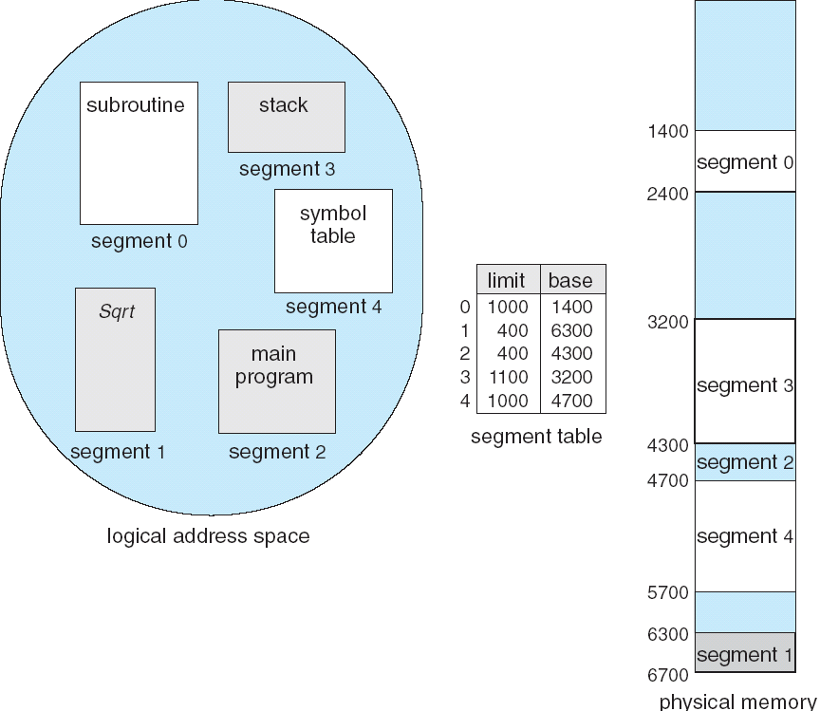
Example of Segmentation

Slide 36
End of Chapter 8

